Slide 1

URMC Caregiver Project
Midterm Presentation
Chenwei Wu
Haosong Rao
Xuening Zhang
Meizhu Wang

Slide 2

Agenda
Revision of Goals
Achievements Since Last Presentation
Progress Since Last Presentation
Upcoming Milestones
Github – Work & Time Structure
Feedback
Q&A

Slide 3
Revision of Project Goals
Goal: Predict quality of life of caregivers for older patients with advanced cancer
Objectives:
Part 1. Pattern Mining for Cancer Treatments: Clean and group cancer treatments into proper class and generics using existing messy dataset 
Part 2. Machine Learning: Develop predictive models for caregiver outcomes such as physical (to be completed) and mental health state, and compare these models to the logistic regression models in previous literature

Slide 4
Recap from Previous “Next Steps”
Have the 42 remaining rows in part 1 dataset manually labelled by clinicians, thanks to Mustafa and Amita! 
Continue exploratory analysis and discuss the issues about missing data with URMC team. 
Run spearman correlation analysis
Try out different ML models and see how they perform compared to Logistic Regression.  Done for mental health variables

Slide 5
Predictive Models for Mental Health Outcome Variables
Cgdistress(Caregiver Impaired Distress)
Cggad7(Caregiver Impaired Anxiety)

Slide 6
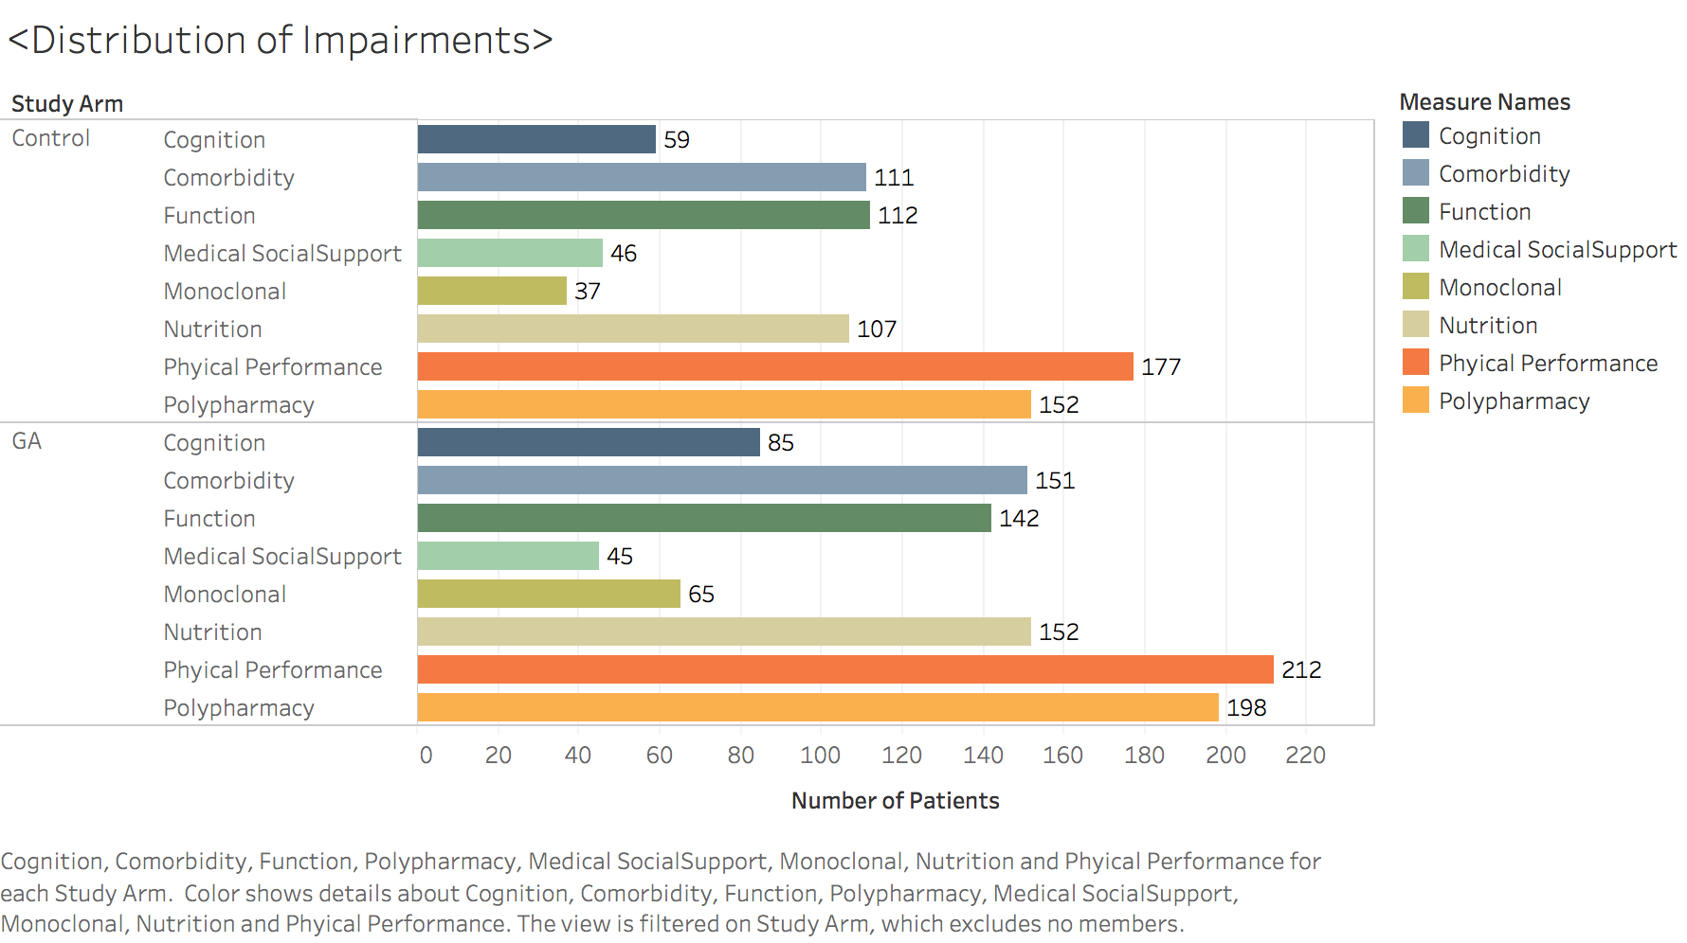
Visualizations

Slide 7
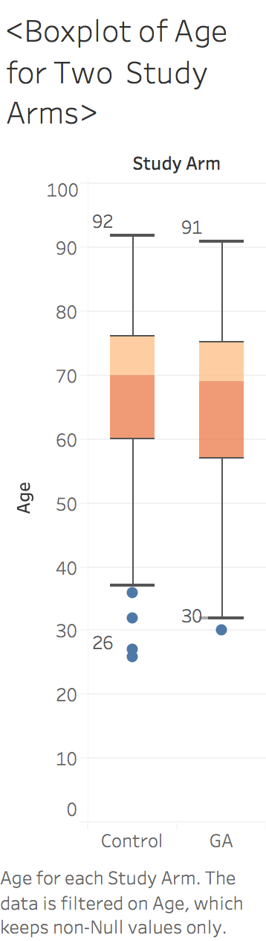
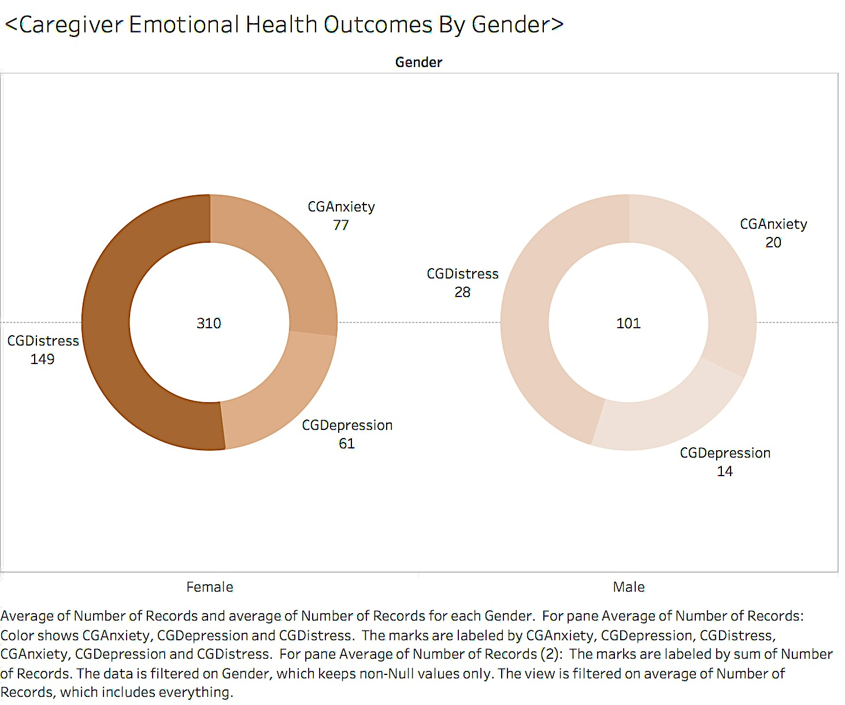
Visualizations

Slide 8
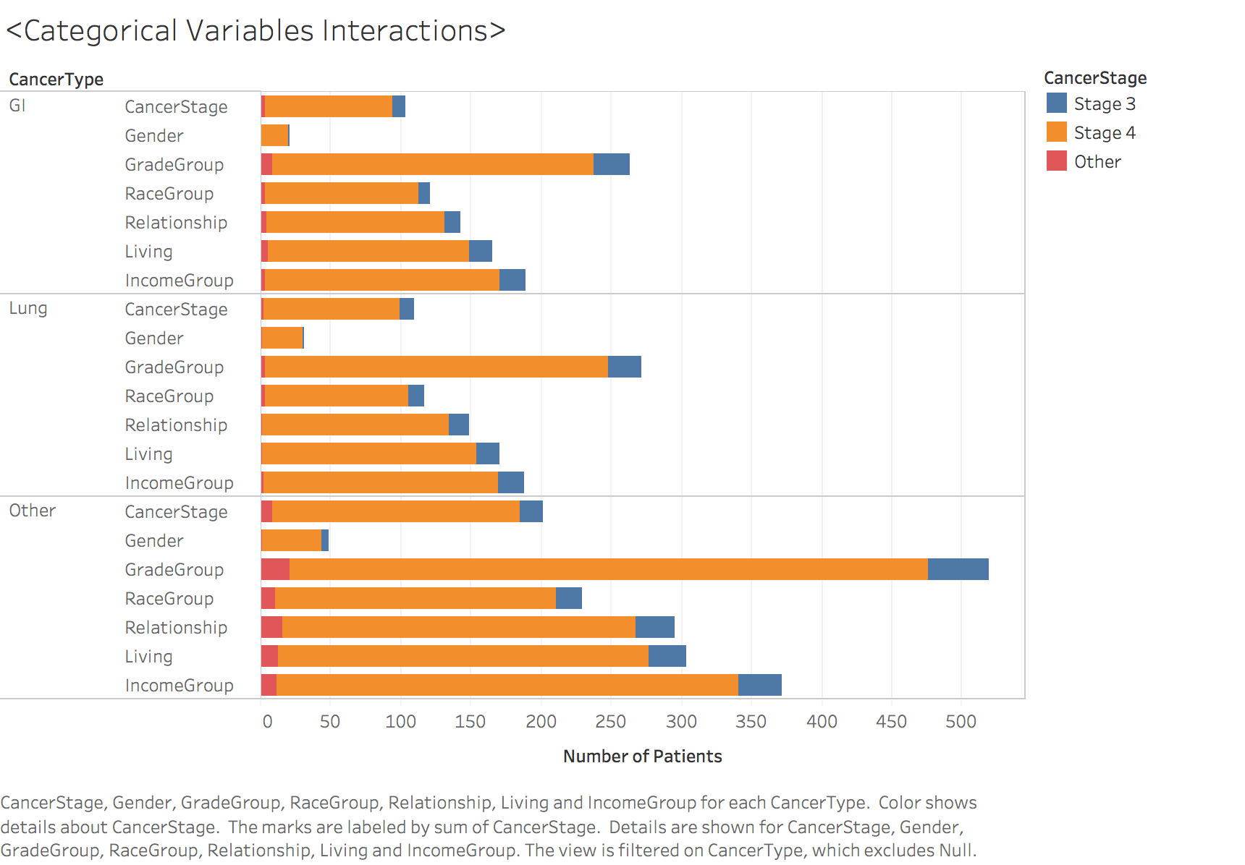
Visualizations

Slide 9
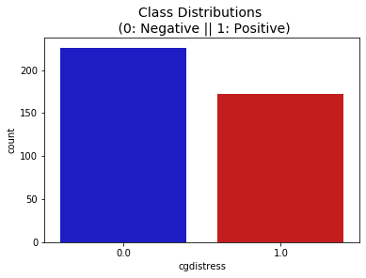
Caregiver Distress
Preprocessing:
Cgdistress has 226 zeros (Caregiver impaired distress<4) and 172 ones (distress>=4), so no data imbalance
We rid the data of NaNs, transformed categorical variables into one-hot encoding form and dropped one for each to avoid multi-collinearity.
Data split 4-1 between train & test.

Slide 10
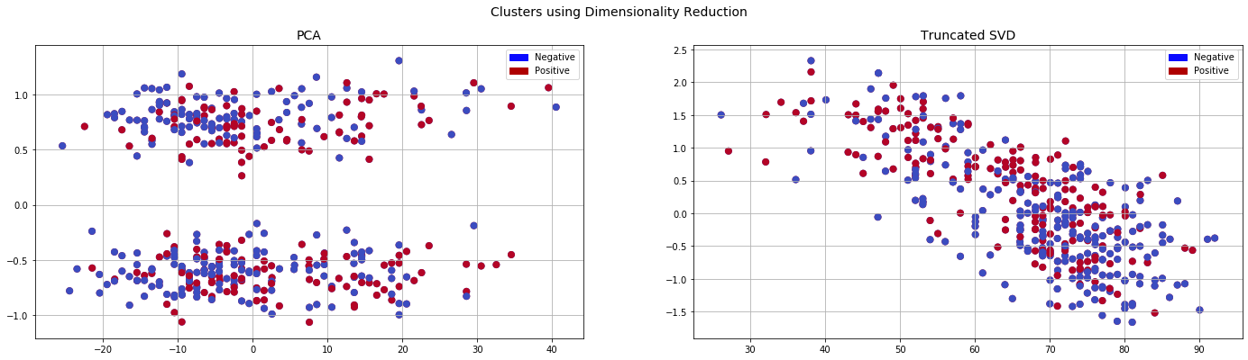
Caregiver Distress
Let’s look at the data in 2D after PCA

Slide 11
Caregiver Distress
Spearman
Correlation
Matrix Analysis:
-patient distress
-age
-gender
…

Slide 12

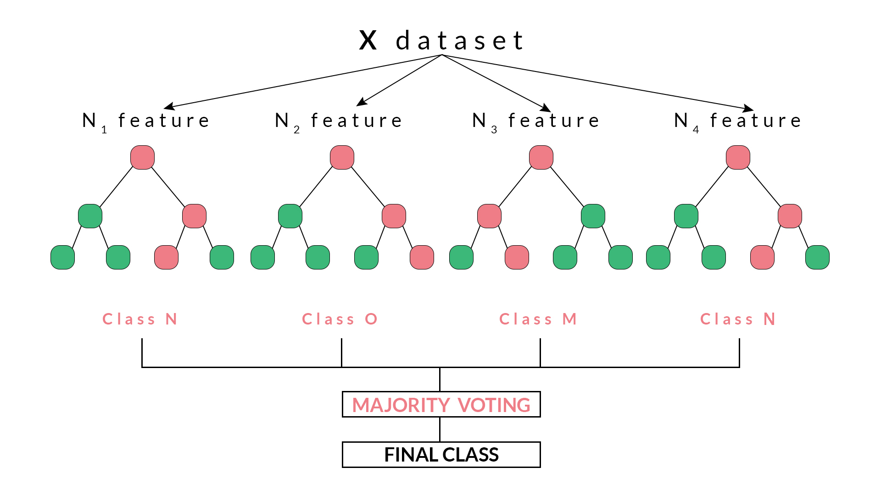
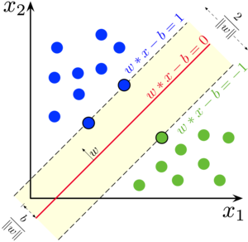
Caregiver Distress
Algorithms Overview
Implemented through scikit-learn and imbalance-learn several classical machine learning methods, including Logistic Regression, KNN Classifier, Ada Boost, an ensemble tree learning algorithm, Random Forest and Support Vectors Machine.
e.g. Random Forest
e.g.
SVM

Slide 13
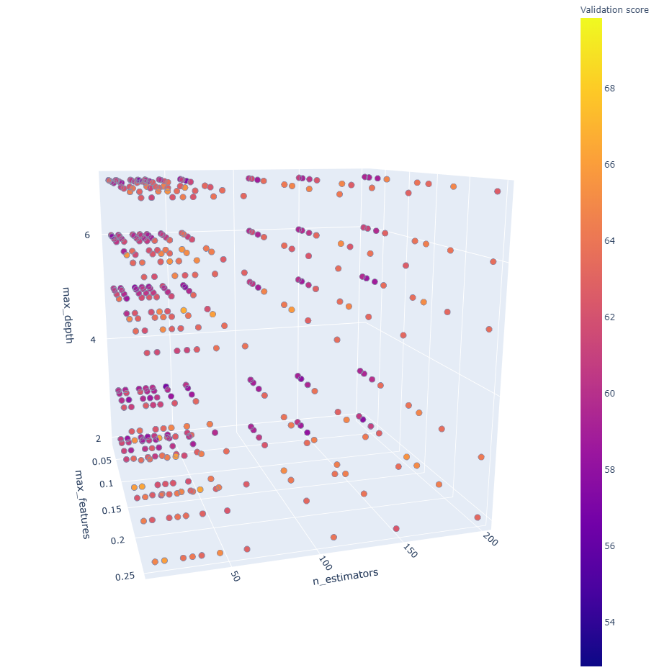
Caregiver Distress
Grid Search for Model Selection (5-fold CV)
Green arrow means increase in accuracy and Red means decrease. Thus we see if we blindly increase number of estimators(trees)or the max depth of trees, in other words, increase the complexity, the model will overfit. Thus we need to grid search in order to find optimal models.

Slide 14
Caregiver Distress
CV Results for models tested (on ~300 data points)
Test Results for selected models (on ~100 data points)
 | RF | SVC | Logistic | KNN | Adaboost
Avg Accuracy | 0.698 | 0.67 | 0.61 | 0.62 | 0.63
Combinations | 135000 | 44955 | 4205 | 1500 | 8250
 | RF | SVC
Accuracy | 0.6875 | 0.67
AUC | 0.71 | 0.67

Slide 15
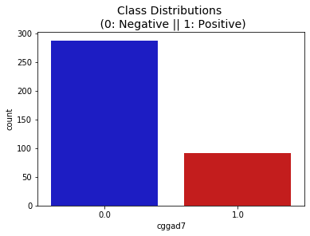
Caregiver Anxiety
Preprocessing:
Cggad7 has 300 zeros (Caregiver impaired distress<5) and 97 ones (distress>=5), so big data imbalance exists.
How to deal with it?
SMOTE (oversampling by creating synthetic data points)
Downsampling (not feasible. If we downsample the 300 to 97 we will shrink the dataset size by half)
Also means accuracy is no more a feasible way to evaluate the model, instead we should use recall/F1 score (discuss in a minute)

Slide 16
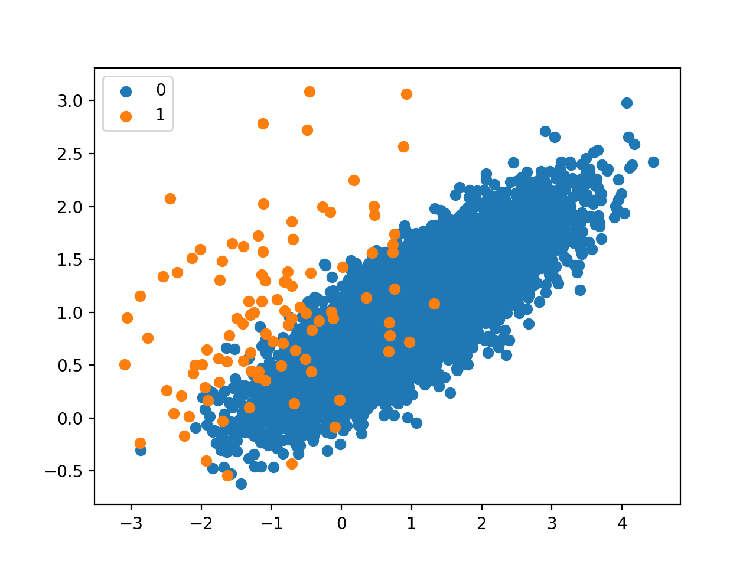
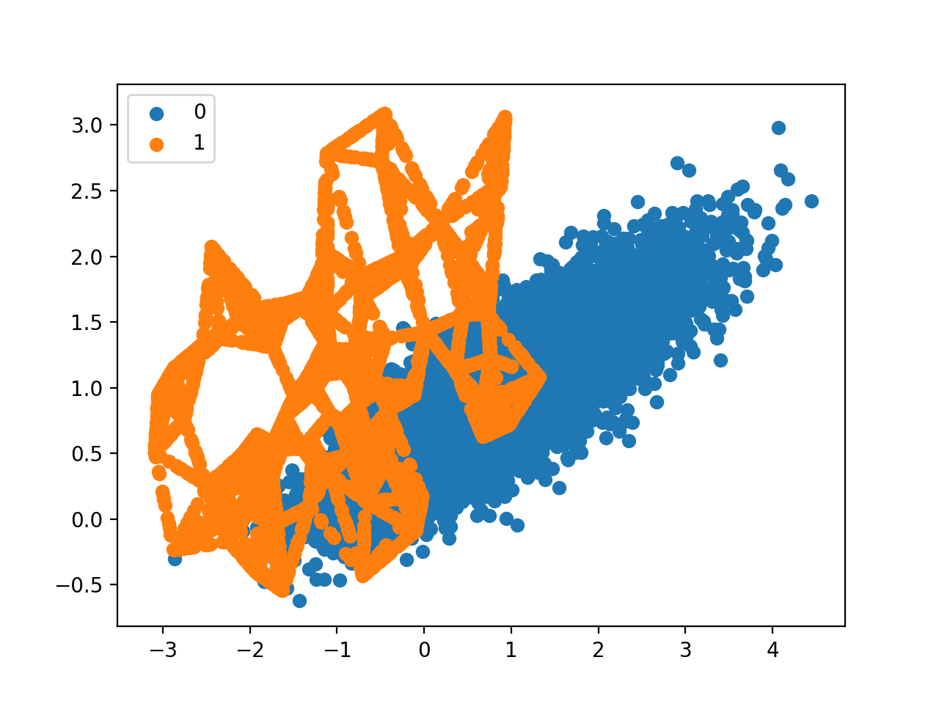
Caregiver Anxiety
What is SMOTE?
SMOTE(implemented via Imblearn) works by selecting minority class examples close in the feature space, drawing a line between the examples in the feature space and creating a new sample at a point along that line.

Slide 17
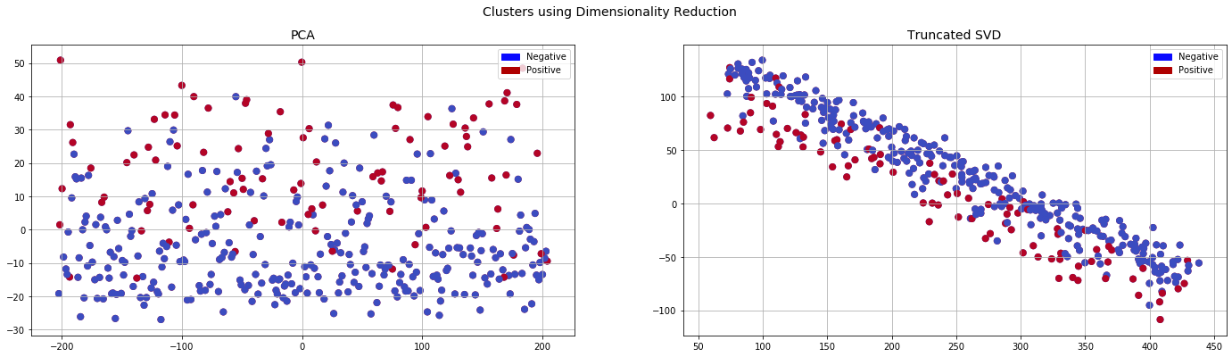
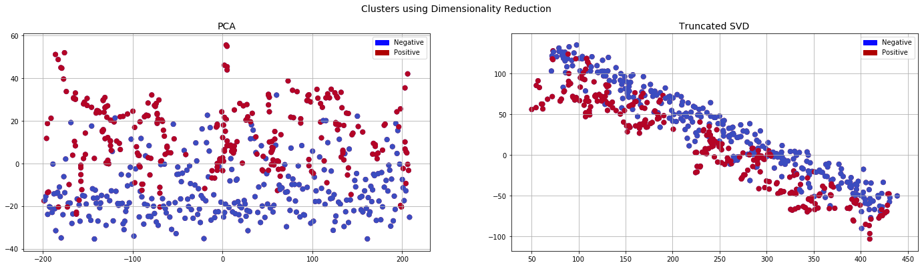
Caregiver Anxiety
Let’s look at the data in 2D after PCA (Original vs. KNNSMOTE)

Slide 18
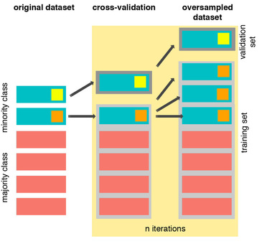
Caregiver Anxiety
Cross Validation with SMOTE
Same as for cgdistress, we performed Grid Search and cross validation to tune the hyperparameters of Random Forest classifier and SVM classifier.
(Must smote right before each cv!)
Using a pipeline, we perform Smote in each cross-validation fold, making sure that the model is trained on a balanced data set and validated on the imbalanced real data. The evaluation was also done on a test set containing only original data.

Slide 19
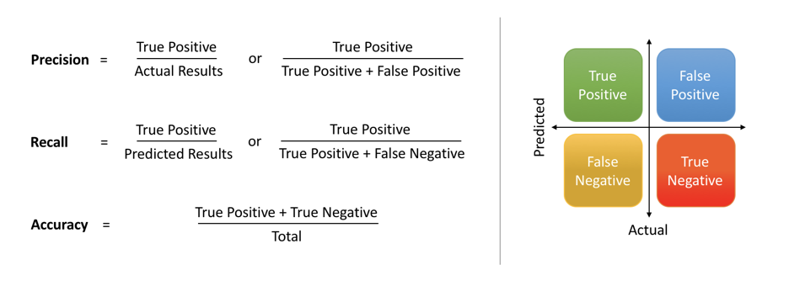
Caregiver Anxiety
In our case, total number of positives is small, let alone the true positives, which makes Accuracy vulnerable to distortions by large number of True Negative.
Change of Scoring
After some tuning based on accuracy as measure, we first found the best models based on accuracy, 77.8% for Random Forest and 77.2% for SVM, seemingly good but the prediction accuracy for class 1 (positive) is low.
For example, RF on test set has a poor positive class accuracy of 22% despite 81% negative class accuracy, which means the model simply classifies most as negative.

Slide 20
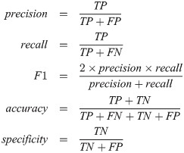
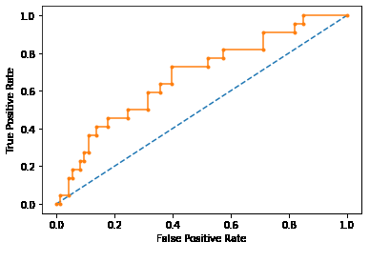
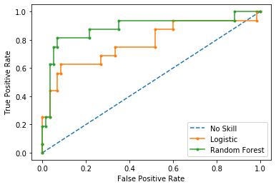
Caregiver Anxiety
Results so far (RF) -1
Since the machine learning task here puts more emphasis on finding positives (that caregiver has shown anxiety and depression), we shouldn’t let our model be skewed by true negatives and need to prioritize true positives.
Then we searched best models based on F1, the weighted precision and recall.
We also looked at models’ precision and recall trade off curve to determine a good decision threshold value. (optimal is around 0.3-0.4 here instead of 0.5)
AUC 0.675 if based on Accuracy
v.s.
AUC 0.885 (RF) based on F1

Slide 21
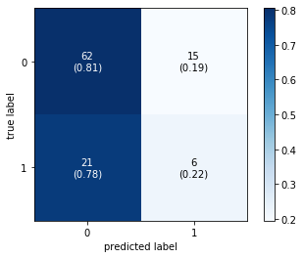
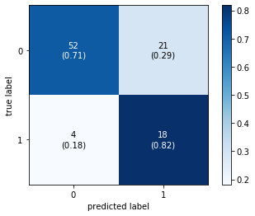
Caregiver Anxiety
Results so far (RF) -2
We can see drastic improvements by looking at the confusion matrices generated and AUC.
V.S.

Slide 22
Upcoming Milestones
Explore other possible measures to further improve results(Clustering to detect outliers for class imbalance problem.)
Work on other 4 features (complete as many as possible before due)
Finish part 1 with newly added data from Mustafa and Amita
Prepare for URMC data team meeting

Slide 23
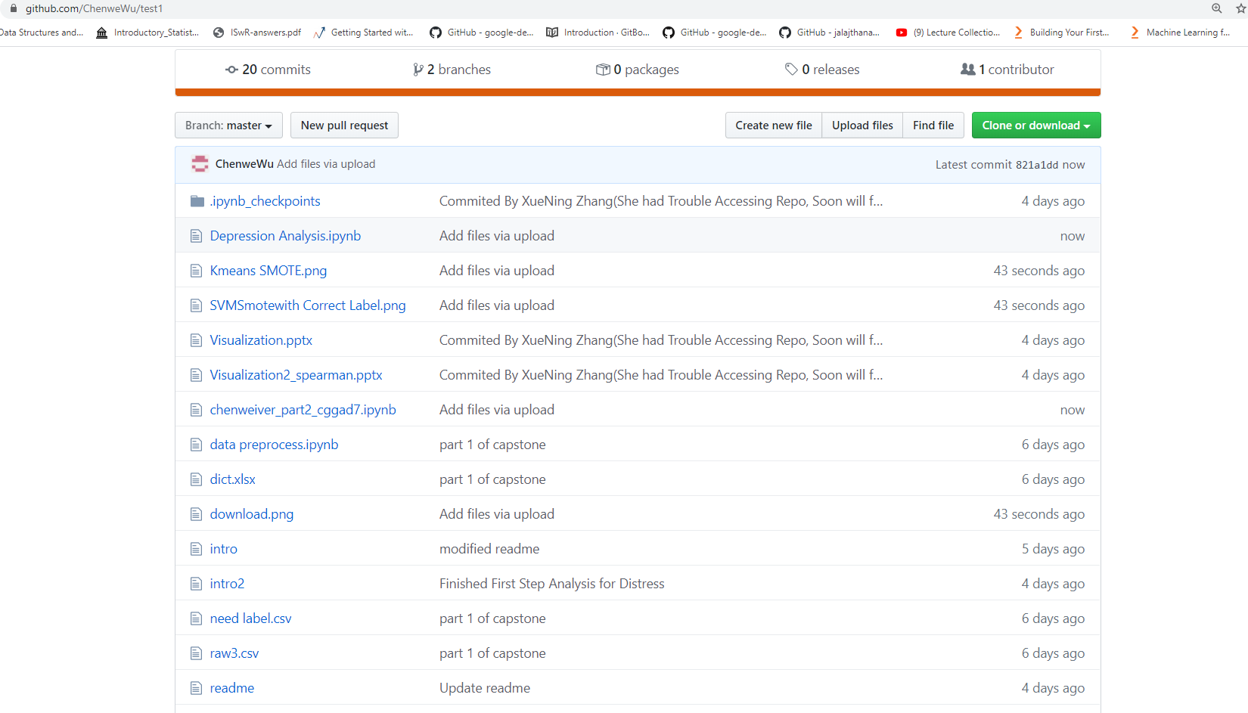
Github Repo /ChenweWu/test1

Slide 24
Progress Breakdown
03/05 URMC Meeting: Project Charter finalized, Part I explained
03/06 Team Meeting: Part I
Chenwei & Haosong: Association Mining and Data Classification
Xuening: Data Exploration and Visualization
03/19 URMC Meeting Part I report, Forwarding remaining labels to oncologist
03/20 Team Meeting: Part II
Chenwei & Haosong: Caregiver Anxiety (Cggad7) and Caregiver Distress (Cgdistress) Model Building and Tuning
Xuening: Spearman Correlation Analysis
04/02 URMC Meeting Reply from Part I; Part II report
04/03 Meeting with Professor Anand: Question regarding Part II
04/05 Team meeting: Midterm presentation

Slide 25
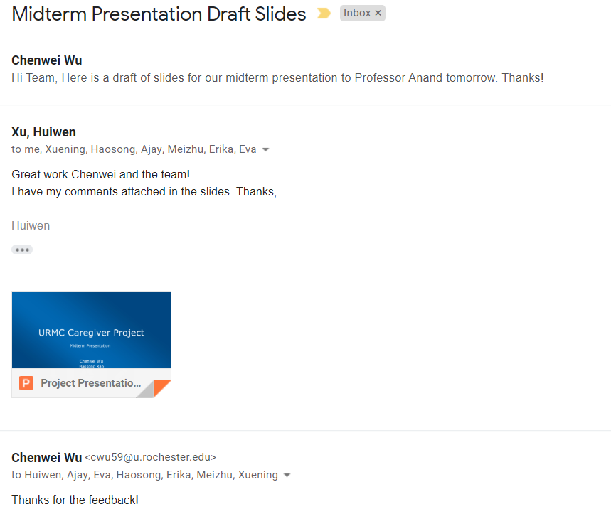
Sponsor Feedback -from Professor Xu

Slide 26
Sponsor Feedback -from Professor Xu
Great progress so far, I especially love the SMOTE which helps the data imbalance a lot.
As next step, we need to test more algorithms on the test set. Ensemble learning like Superlearner might be a good option
Also, I would like to see variable importance for both outcomes.
Thanks for all your hard work! Great team to work with!

Slide 27
Q&A
Thank you!

Slide 28


